Slide 1

MKTG7050
Consumer Behaviour and Analysis
(MKTG2031 Consumer Behaviour Online)

Slide 2
Week 1 Topics
L1.1 Brief course overview
L1.2 Introduction to Consumer Behaviour
L1.3 Theoretical Perspectives on Consumption
L1.4 Consumer Research Perspectives
L1.5 Consumption Types
L1.6 Marketing Ethics

Slide 3
Contact Information
Lecturer: Dr. Toni Eagar
Room: CBE 2.23
Email: toni.eagar@anu.edu.au
Consultation:
Wednesday 10-12pm (this is likely to change due to timetable changes I’ll send an announcement once a new time is confirmed)
Office or via Teams
Book via link on Wattle
Select Consultation type
Select date and time
Once you have booked, you will receive a calendar event. SAVE this in your calendar!
If you select an online consult, you will be emailed a link

Slide 4
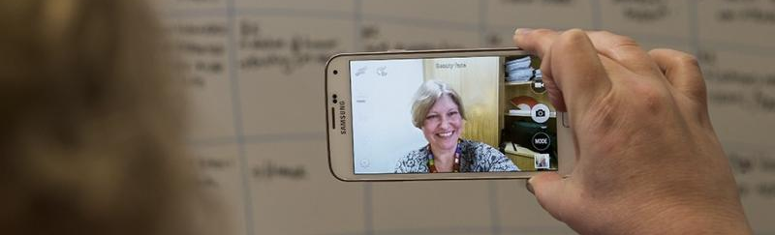
Who I am
PhD in marketing from ANU.
B.Bus (Hons)/B.Arts (International Studies) from UTS, Sydney
Worked in marketing research
Research interests:
Consumer culture theory
Celebrity / human / artist brands
Brand / fan / online communities
Individual and brand identity

Slide 5
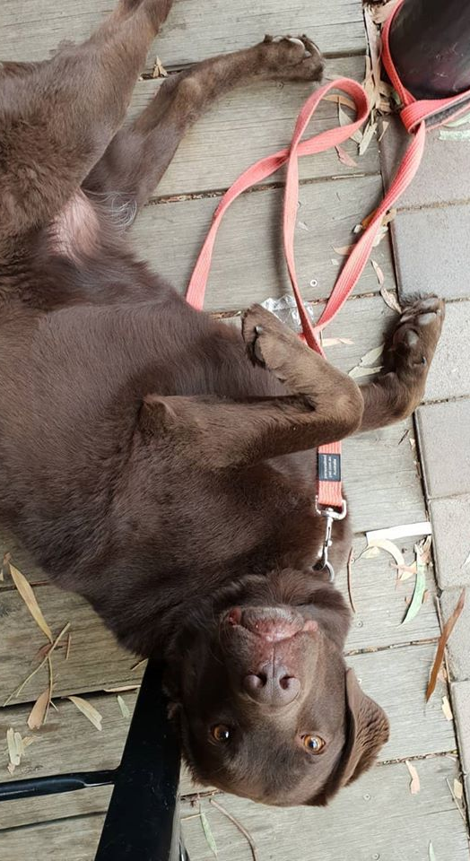
Who I am
I have lived in Malaysia and traveled extensively
Married with dog
I am not psychic*

Slide 6
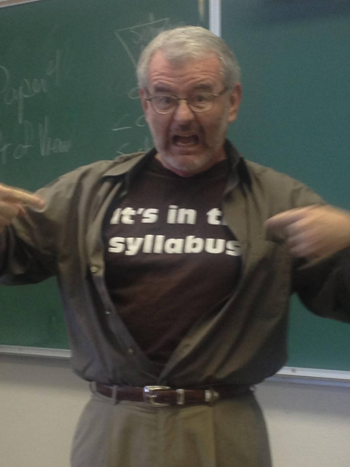
What’s expected of you
READ THE CLASS SUMMARY (P&C and Wattle)
This is your contract with me and the university.
Know what you’re signing up to
READ THE COURSE INFORMATION (Wattle)
Engage in continuous learning and assessment
Meet deadlines that are given
Penalties will be applied
This is a fairness and equity issue
If you are in trouble let me know*
See Wattle
*Because I’m not psychic

Slide 7
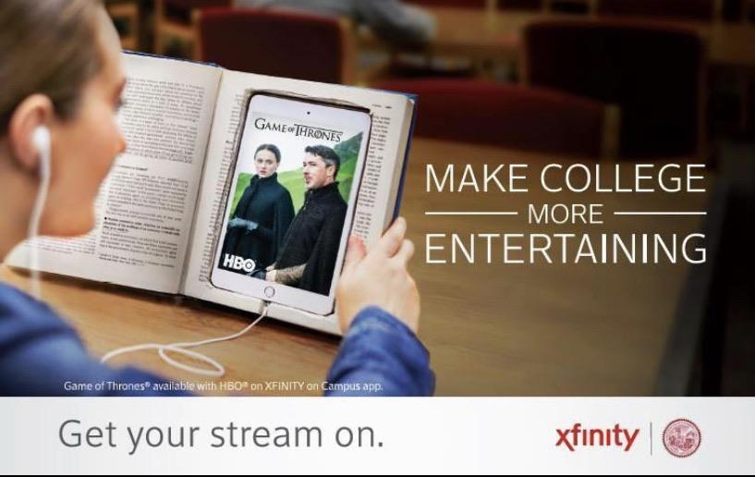
What I expect of you
Be prepared
Be respectful
Have fun

Slide 8
Navigating Wattle
When is stuff happening:
Class summary or Semester calendar
What do I need to study:
Course resources section:
Multiple textbook access options
Course readings (including textbook via the library)
Learning resources and guides
Assumed knowledge material
Academic integrity
Other helpful stuff
Lecture Resources
Lecture Slides
Echo360 lecture recordings
Tutorial Resources
Tutorial forum (weekly posts)
What do I need to do:
Class summary
Assessment overview
Individual assessment briefs
Where do I submit:
Assessment tasks 1,4, and 5
Links in individual assessment sections
Assessment tasks 2 and 3
Tutorial Resources → Tutorial forum
Keeping up to date:
Course announcements (email and forum)
Email

Slide 9
L1.1: Introduction to the course

Slide 10

THEORY
AHEAD
It cannot be avoided, evaded, dodged or ignored

Slide 11
Course Description
The course will provide a theoretical account of consumption as a (mainly) cultural activity: consumers interact with each other, with the market, and socio-cultural institutions by means of consumption acts and activities. Through consumption, consumers express their identity and contribute to the development and change of marketplaces and popular culture. As such, consumption can be seen as both a collective, aggregate cultural phenomenon and an individual, subjective activity to satisfy needs and wants. The course will review consumer culture and consumer behaviour theories in order to understand these alternative viewpoints and their implications for marketers.

Slide 12
Course learning outcomes
Identify relevant consumer culture and consumer behaviour theories;
Examine relevant theories in individual, marketplace and cultural contexts;
Relate the consumption experiences of others to relevant consumer culture and behaviour theories;
Critique relevant consumer culture and behaviour theories in the individual, marketplace and cultural contexts;
Demonstrate the use of evidence and theory in applying marketing strategies and tactics; and
Report a personal reflection on consumption experiences.

Slide 13
Course Structure
Foundations of Consumer Behaviour
Week 1 Introduction
Consumers'’ Hearts and Minds
Week 2 Perception
Consumers in their Social and Cultural Settings
Week 6 Groups and Social Influence
Consumers’ Decisions and Choices
Week 3 Learning and Memory
Week 4 Personality / Motivation
Week 5 Values / The Self
Week 7 Subcultures 1
Week 8 Subcultures 2
Week 9 The Culture of Consumption
Week 10 Attitude and Attitude Change
Week 11 Individual Decision Making
Week 12 Buying

Slide 14
Assessment Overview
Assessment Task | Weight | Completion | Submission Information
1. Quizzes | 10% | Individual | Weekly
2. Consumption Activities | 10% | Individual | Weekly in tutorials
3. Activity Presentations | 10% | Group | 1 x In tutorials
4. Consumption Journal | 30% | Individual | W6 Thurs @ 23:59pm
5. Examination
5a. Consumer Profile Slide |  |  | Shared at start of Oral Interview
5b. Oral interview | 40% | Individual | 12 minutes @ Selected time slot during the exam period (3rd-13th June 2025)

Slide 15
Assessment Skill Development
Assessment Task
1. Quizzes
2. Consumption Activities
3. Activity Presentations
4. Consumption Journal
5. Examination
5a. Consumer Profile Slide
5b. Oral interview
Content Knowledge

Slide 16
Assessment Skill Development
Assessment Task
1. Quizzes
2. Consumption Activities
3. Activity Presentations
4. Consumption Journal
5. Examination
5a. Consumer Profile Slide
5b. Oral interview
Content Knowledge
Analysis Skills

Slide 17
Assessment Skill Development
Assessment Task
1. Quizzes
2. Consumption Activities
3. Activity Presentations
4. Consumption Journal
5. Examination
5a. Consumer Profile Slide
5b. Oral interview
Content Knowledge
Analysis Skills

Slide 18
Assessment Skill Development
Assessment Task
1. Quizzes
2. Consumption Activities
3. Activity Presentations
4. Consumption Journal
5. Examination
5a. Consumer Profile Slide
5b. Oral interview
Analysis Skills

Slide 19
Lecture format
I’ll discuss the various concepts
We’ll be doing self-test quizzes in the lecture:
Hint: These will be helpful in doing the weekly quizzes.
Administrative Matter:
Public holiday Mondays – Options
Pre-recorded lecturer (with self-quiz options)
Rescheduled In-person lecture

Slide 20
Tutorial Format
Week 2 Tutorials
Overview and meet and greet
Activity presentations:
Group formation
Topic selection
Consumption Activity 1
Week 3 onwards:
Activity Presentation
Consumption Activity
Consumption Journal or Consumer Profile Report Activity

Slide 21
Foundations of Consumer Behaviour
Chapters 1 and 2

Slide 22
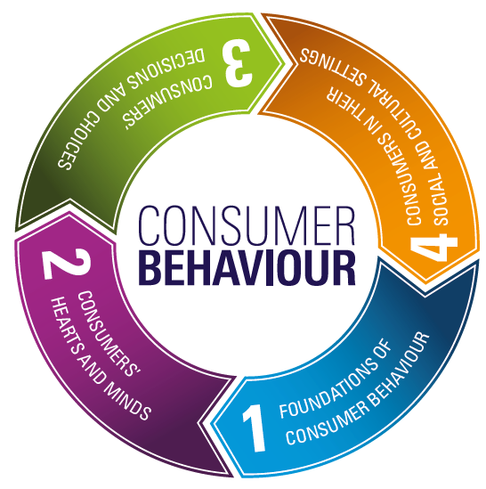
You are here!

Slide 23
L1.2: Introduction: Consumer Behaviour
Why do we study consumers and consumption?

Slide 24

What is consumption?
Notes:
The process by which consumers use and transform goods, services, or ideas into value
(Babin & Harris, 2015)
In economics, the use of goods and services by households
Dictionary:
the action of using up a resource.
a wasting disease, especially pulmonary tuberculosis.

Slide 25
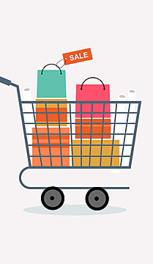
What is Consumer Behaviour?
The study of the processes involved when individuals or groups select, purchase, use or dispose of products, services, ideas or experiences to satisfy needs and desires.

Slide 26
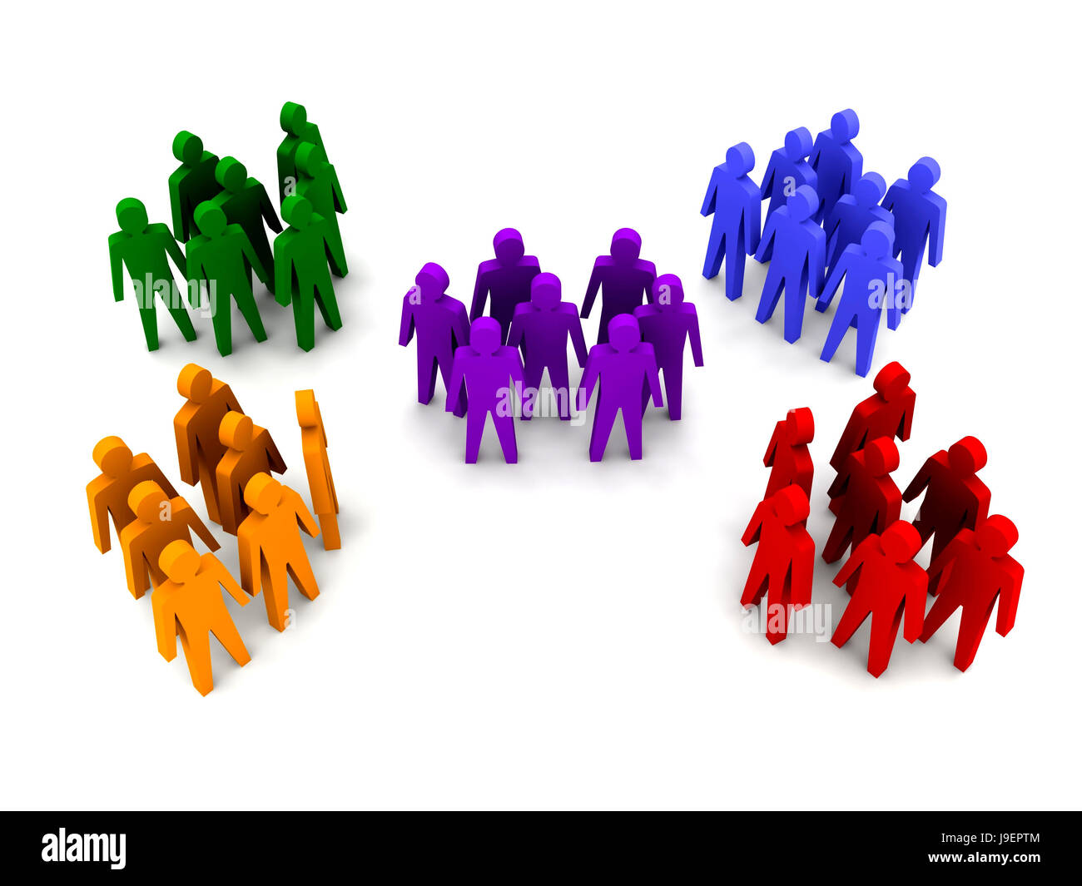
Segmentation – Targeting - Positioning

Slide 27

Segmentation, Targeting and Positioning (STP)
Goal | Implication
Identifying relevant segmentation variables | grouping by individual differences
Understanding how to communicate to target segments | applying appropriate marketing mix tactics
Understanding how the target segment is likely to perceive / respond to marketing efforts | achieving desired consumer response

Slide 28
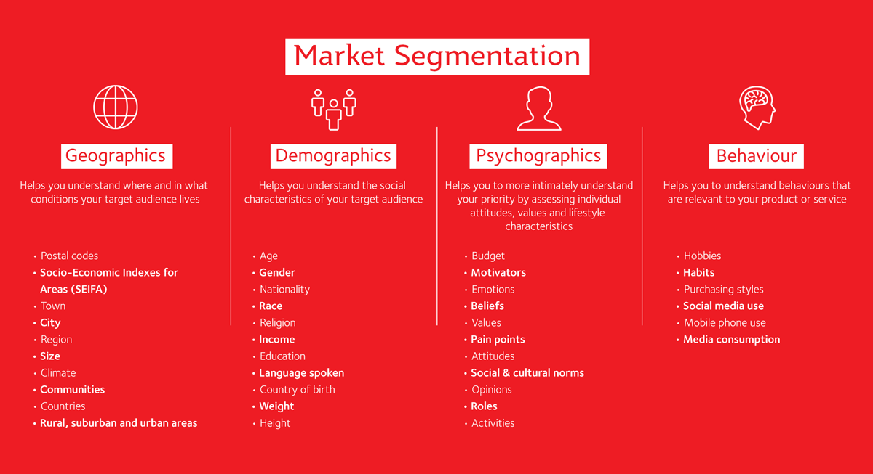
Segmentation Methods and Variables

Slide 29
L1.3: Consumption: Theoretical Perspectives
How we understand consumption

Slide 30
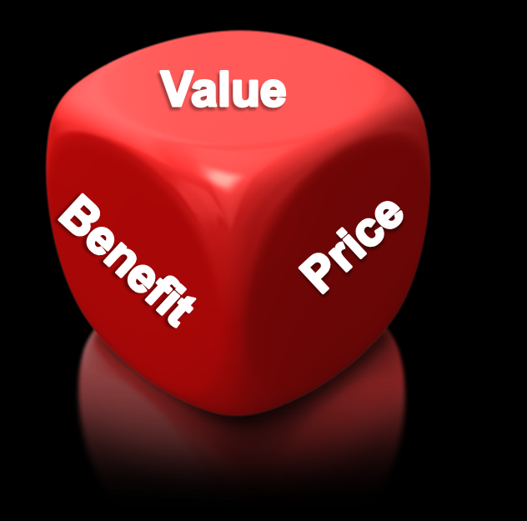
Q: Why do we consume? A: Value!
Notes:
Benefit: What is offered
Value: What is experienced
Price: What is exchanged

Slide 31
Value types
Exchange value: a transaction in which two or more organisations or people give and receive something of value, e.g. market price.
Value-in-use: the satisfaction from a good or service’s attributes and quality when they are consumed, i.e. the consumption experience
Symbolic value: consumptions as a means to communicate self- or social-identity.
Value co-creation: rather than previous three types which assume value is unidirectional from producer to consumer; Co-creation is the collaboration between organisations and consumers to create value.

Slide 32
Consumption: Theoretical Perspectives of Consumption
Economic perspective:
Products are a bundle of attributes that yield benefits
Industry creates value – Consumers destroy value
Symbolic perspective:
Products are vessels of meaning that signify similarly across all consumers
Industry creates symbols – symbols are transferred to consumers to create value
Consumer culture perspective:
Consumption is part of market system, and can be creative and destructive
The market system is culturally embedded, involves multiple agents in different power positions
Products are consumed in a variety of ways by different groups of consumers based on the cultural and market systems they are embedded within
Source: Holt, Douglas B (1995). “How Consumers Consume: A Typology of Consumption Practices”. Journal of Consumer Research, Vol. 22(1), pp.1-16.

Slide 33

Example 1

Slide 34
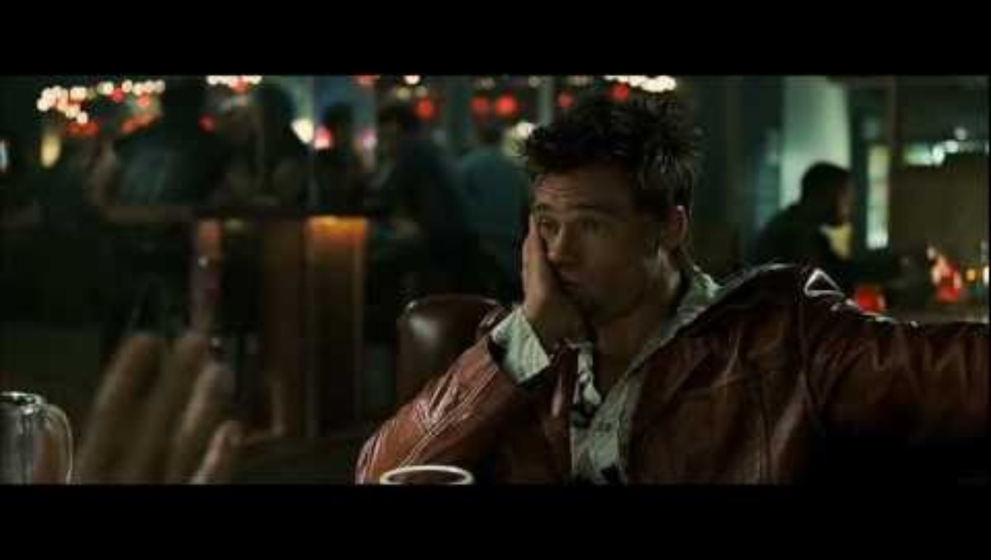
Example 2

Slide 35
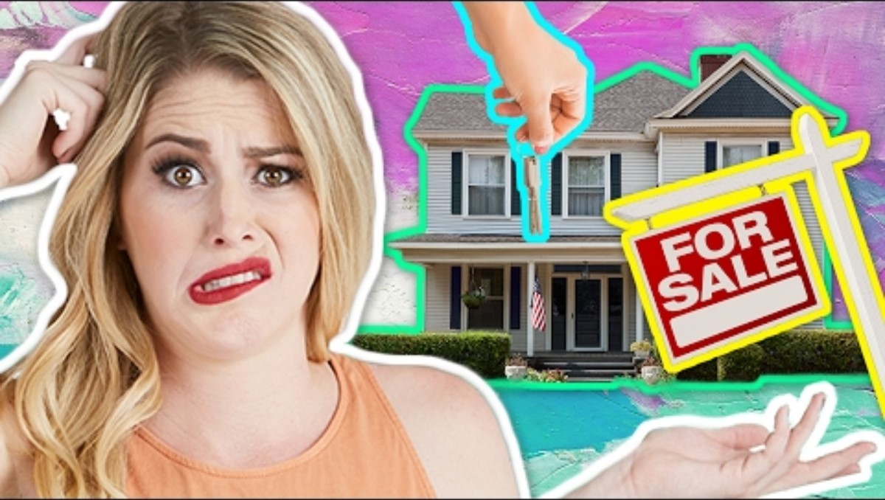
Example 3

Slide 36
L1.4: Consumption: Research Perspectives
How do we understand consumer’s

Slide 37
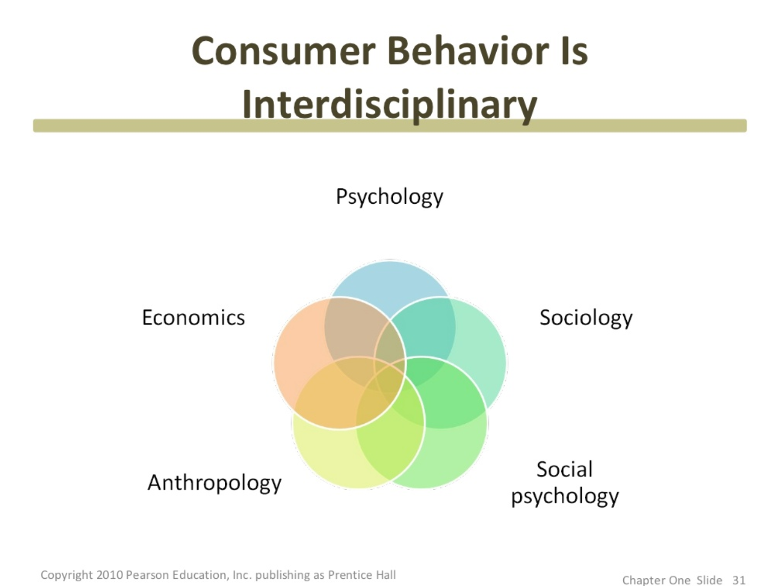

Slide 38

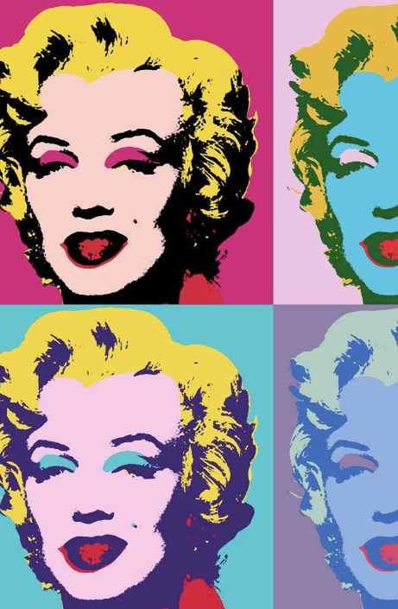
Philosophical Perspectives
Positivism (Modernism)
Interpretivism (Postmodernism)

Slide 39
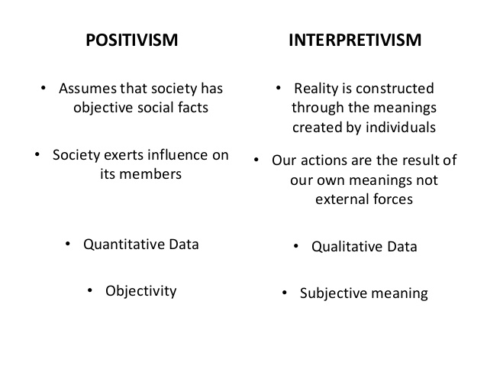
Positivism v Interpretevism

Slide 40

Example of Positivism in Consumer Research

Slide 41
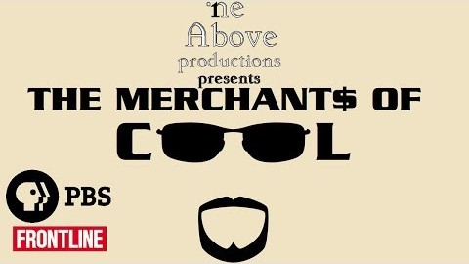
Example of Interpretivism in Consumer Research

Slide 42
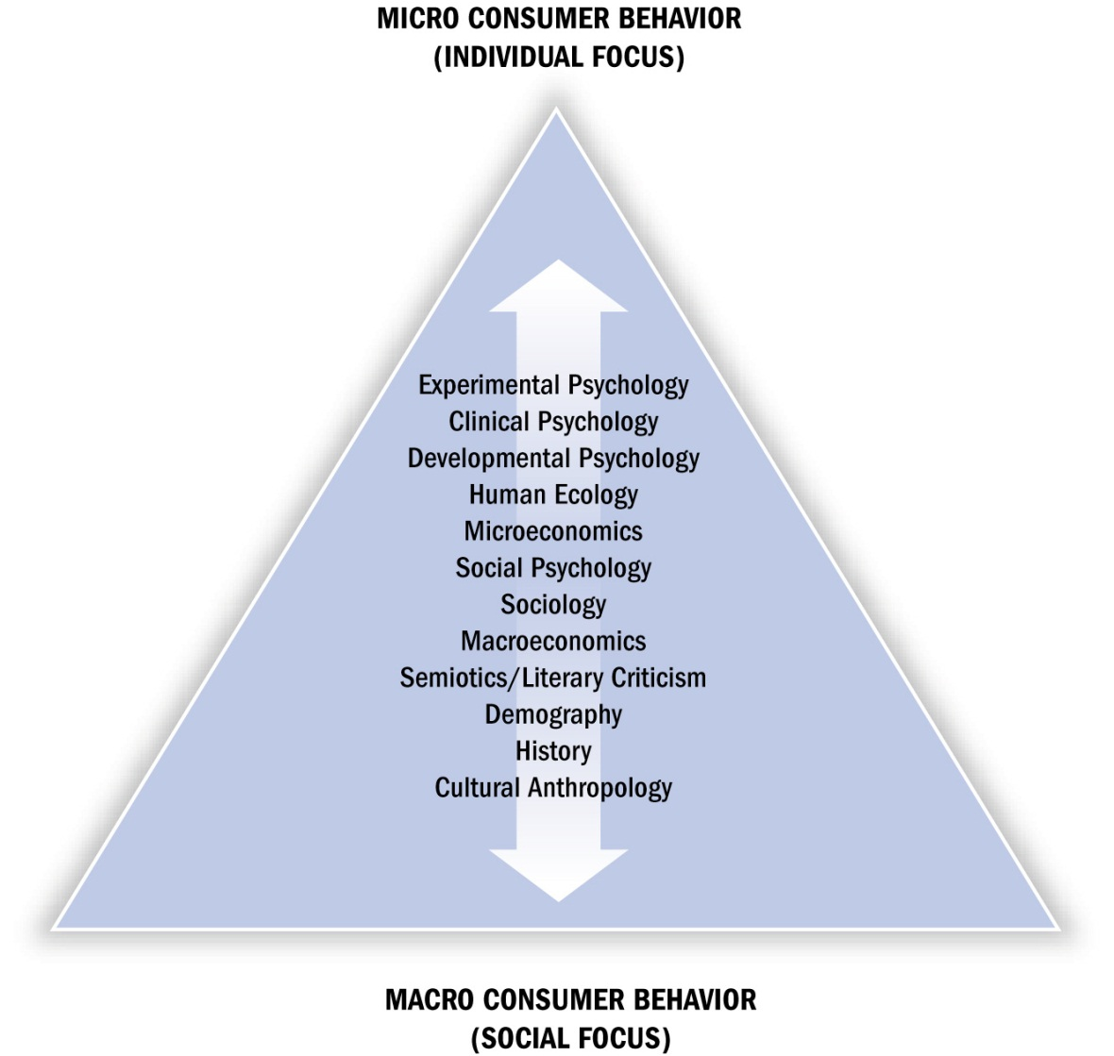
Consumer Research
Positivism
Interpretivism

Slide 43
L1.5: Consumption types
How we consume

Slide 44
Consumption Typologies: How we consume
Consuming as an experience
An emotional or aesthetic reaction to consumption objects
Consuming as integration
Learning and manipulating consumption objects to express aspects of the self or society
Consuming as classification
The activities that consumers engage in to communicate their association with objects both to self and to others
Consuming as play
Consumers use objects to participate in a mutual experience and merge their identities with that of a group
Source: Holt, Douglas B (1995). “How Consumers Consume: A Typology of Consumption Practices”. Journal of Consumer Research, Vol. 22(1), pp.1-16.
Notes:
This article by Holt is available through WebCT as an optional reading

Slide 45

Marketing in Action: Game launches

Slide 46

Consumption Typologies: Gamer Example
Consuming as an experience
I play the game and think its awesome.
Consuming as integration
I build my avatar and choose the storylines to follow.
Consuming as classification
I set my social media profile pic to my avatar.
Consuming as play
I play with others online and join the game’s subreddit to discuss the game.
Source: Holt, Douglas B (1995). “How Consumers Consume: A Typology of Consumption Practices”. Journal of Consumer Research, Vol. 22(1), pp.1-16.
Notes:
This article by Holt is available through WebCT as an optional reading

Slide 47

Example 1

Slide 48
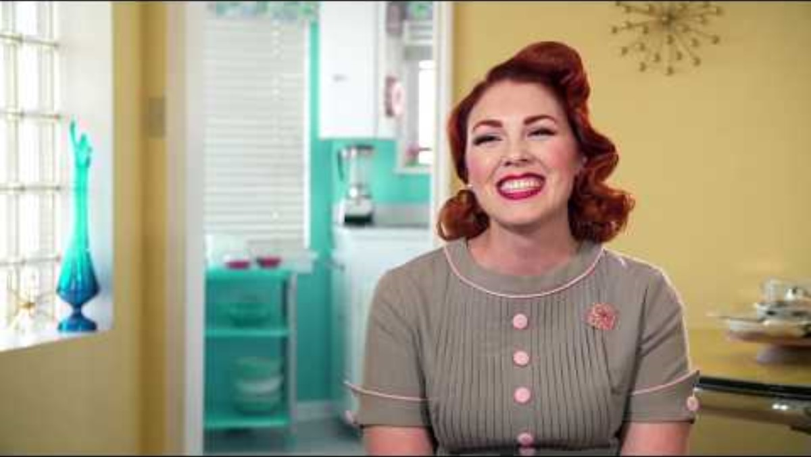
Example 2

Slide 49
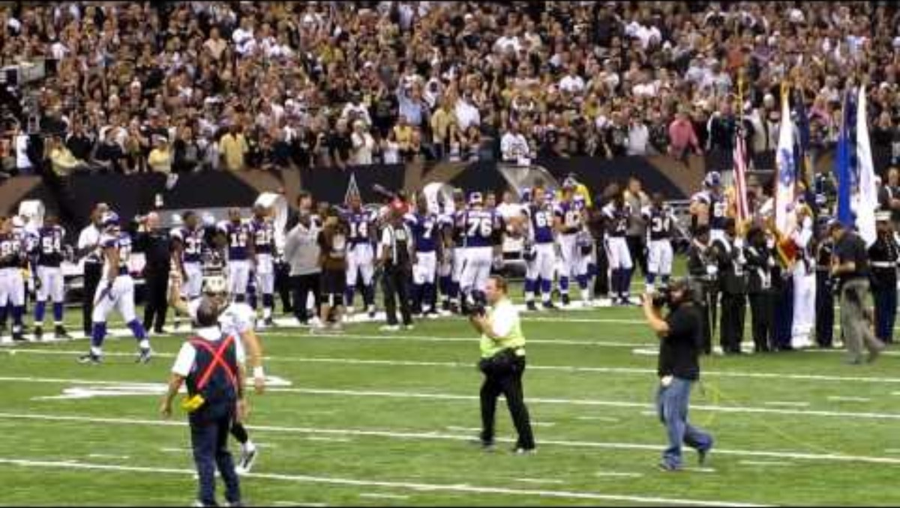
Example 3

Slide 50
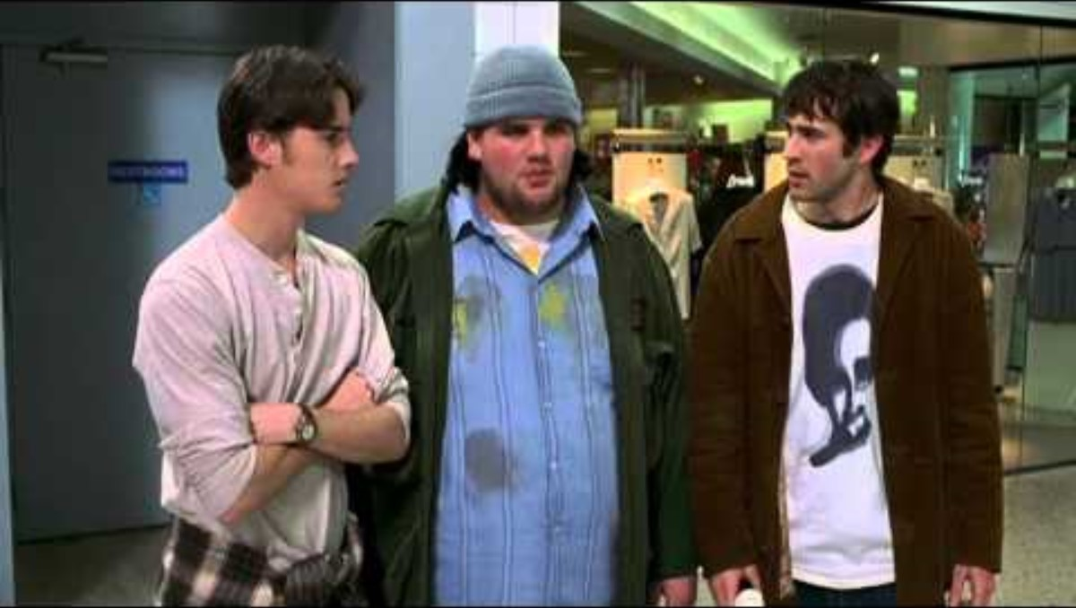
Example 4

Slide 51
L1.6: Marketing Ethics
How we should market

Slide 52
Ethically Speaking: Influence vs Manipulation
Do marketers create artificial needs?
Need: A basic biological motive
Want: One way that society has taught us that need can be satisfied
Are advertising and marketing necessary?
Economics of information perspective: Advertising is an important source of consumer information
Do marketers promise miracles?
Advertisers simply don’t know enough to manipulate people

Slide 53
How much is the individual responsible for consumption?
Buyer beware v Seller regulation

Slide 54
Consumer responsibilisation
“is a moralizing, neoliberal governance process that leverages market logic—free choice, rationality, and individual responsibility—to shift responsibility for addressing social problems from the state to the individual”
(Barnhart, Huff and Scott, 2024: 1009)

Slide 55
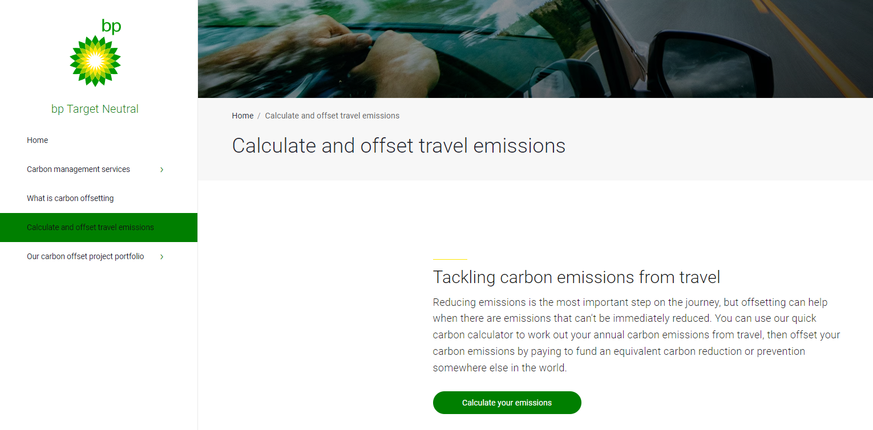
Consumer Responsibilisation in Action

Slide 56

Consumer Responsibilisation in Action

Slide 57
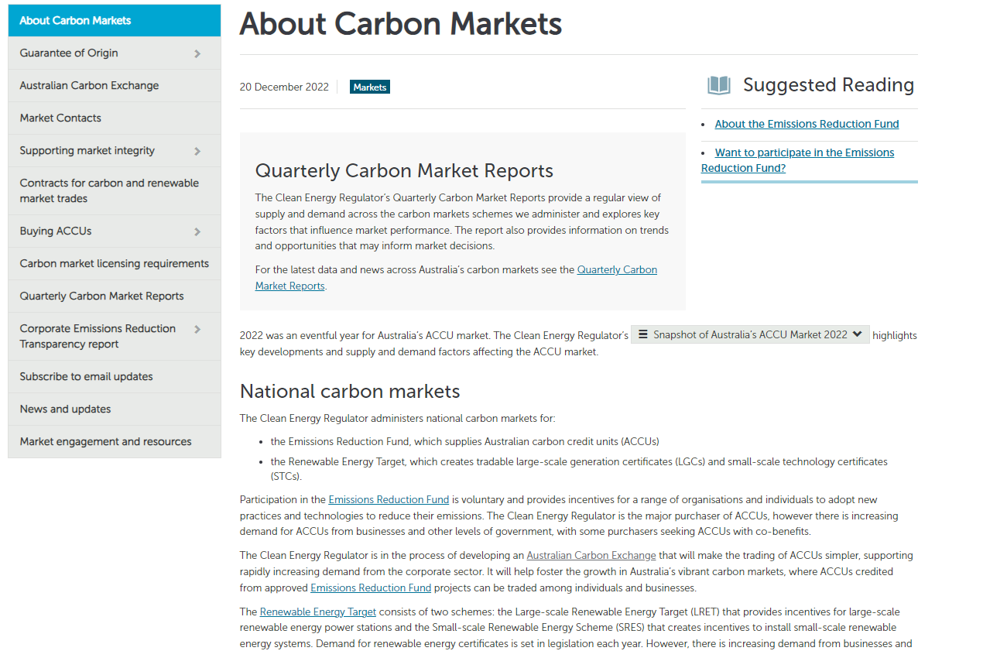
State Solution to Social Problems

Slide 58
Discussion:
Is it consumers’ responsibility to buy no or little plastic?
Is it consumers’ responsibility to recycle plastic?
What are the alternatives to the plastic problem?

Slide 59
The end.

